Slide 1
E-Content
COURSE: BIOCHEMISTRY(18PBT1107)
UNIT: III
TOPIC
AMINO ACID CLASSIFICATION

Slide 2
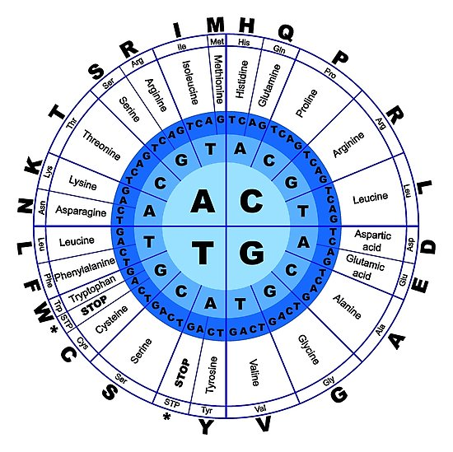
;
Amino Acids

Slide 3
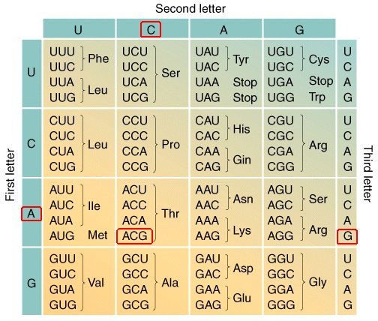

Slide 4
Introduction
Amino acids are a crucial, yet basic unit of protein
Amino acids all have the basic backbone and they contain an amino group and a carboxylic group.
They all consist of a carbon atom (C) attached to a carboxyl group (-COOH), an amino group, (-NH₂), a Hydrogen, and another group of atoms (R).
The R group gives the amino acid its unique characteristics, and allows it to react with other amino acids in unique ways
Every protein sequences starts with amino acid Methionine (Met)

Slide 5
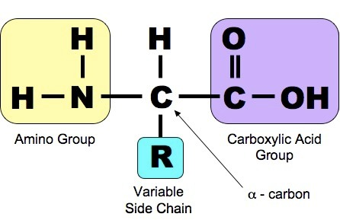
Backbone

Slide 6
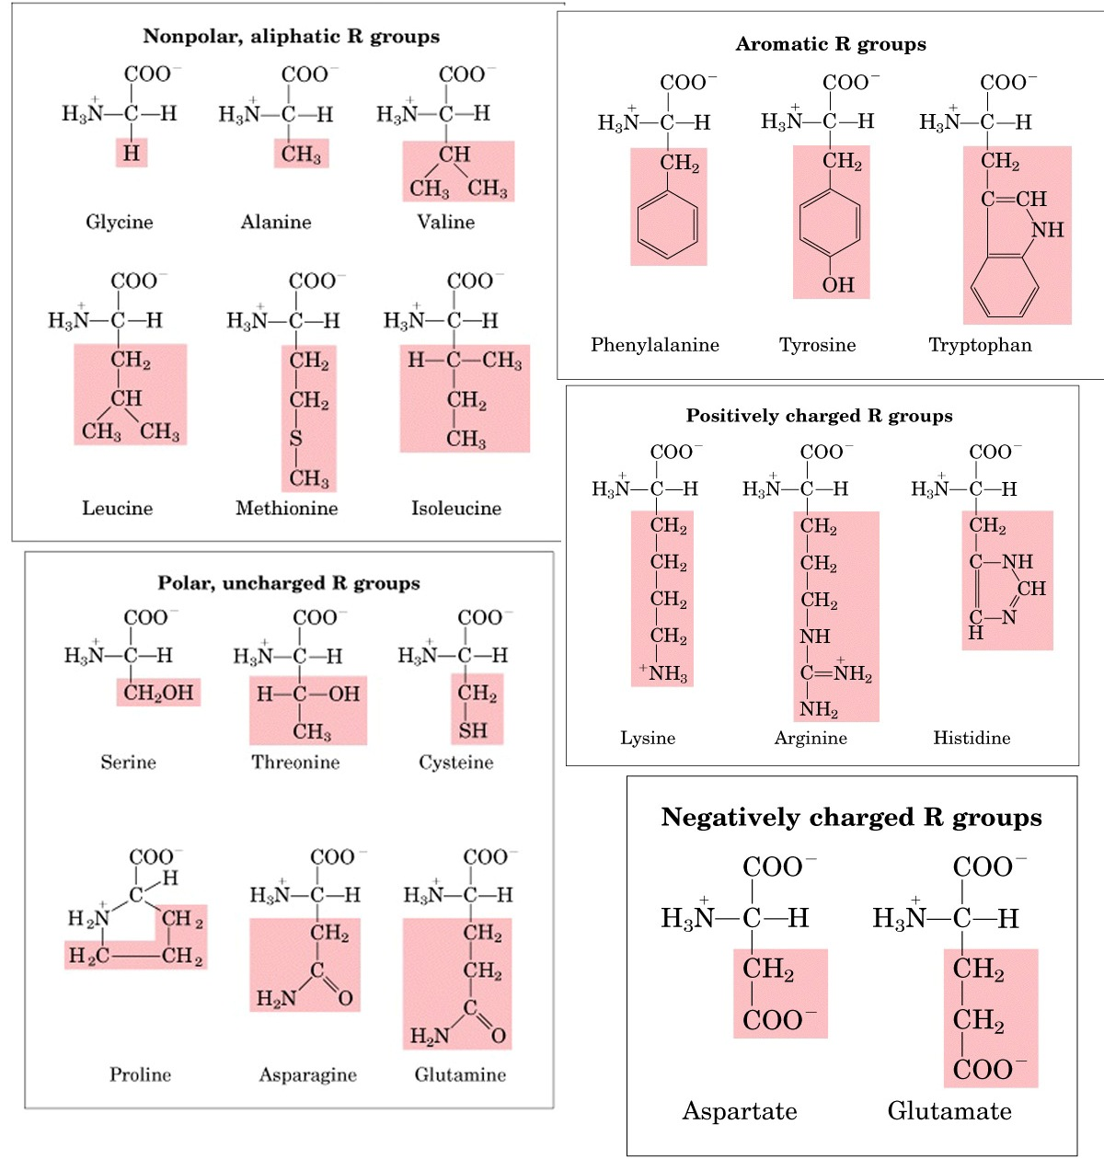

Slide 7
Classification of Amino Acids
There are many ways to classify amino acids, these molecules can be assorted into 6 main groups, on the basis of their structure and general chemical characteristics of their R groups
Classes of Amino Acids | Name of the Amino Acid
Aliphatic | Glycine, Alanine, Valine, Leucine, Isoleucine
Hydroxyl or Sulfur-containing | Serine, Cysteine, Threonine, Methionine
Cyclic | Proline
Aromatic | Phenylalanine, Tyrosine, Tryptophan
Basic | Histidine, Lysine, Arginine
Acidic and their amide | Aspartate, Glutamate, Asparagine, Glutamine

Slide 8
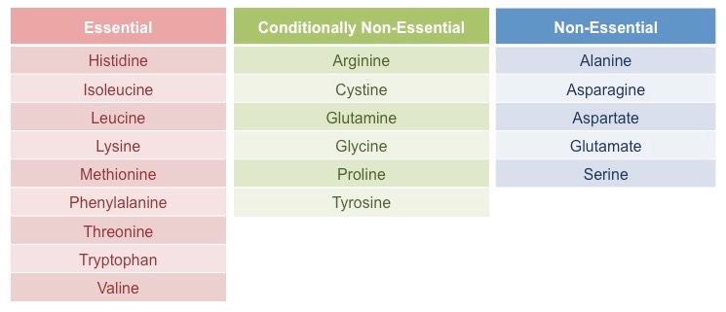

Slide 9
Properties of Amino Acids
Each amino acid has both an acidic and basic group from its backbone structure. This is the reason they behave like salts.
Any amino acid in the dry state is in crystalline form. They exist as a dipolar ion. The COOH group exists as an anion and the NH2 group exists as a cation. This dipolar ion has a special name “Zwitter ions’.

Slide 10
In aqueous solution, alpha amino acids exist in equilibrium between a cationic form, an anionic form and dipolar ion.
The Isoelectric point is the pH point at which the concentration of zwitter ions is the highest ad the concentration of cationic and anionic form is equal. This point is definite for every α-amino acid.
They are generally water soluble and also have high melting points

